Slide 1
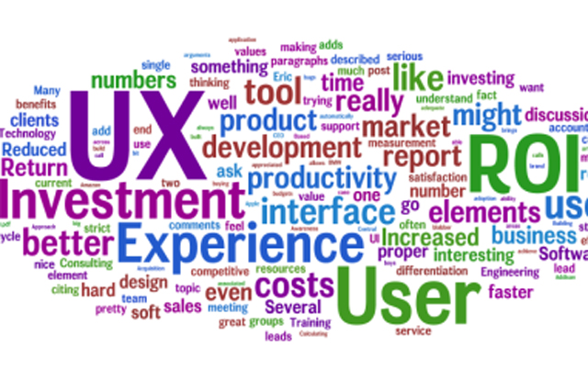
It’s all about users
Marcin Skurczyński
Introduction to Programming for Business

Slide 2
Usability (Nielsen 1993)
Easy
Pleasant
Productive

Slide 3
Human – computer interaction
Workload / task (management)
Computer (IT)
User (psychology)
TASK

Slide 4
Time consequences of wrong design
Reflexes: not intuitive, wrong design; low ergonomy (low: 0,0001-0,001 s)
Rules: forgotten rules, incorrect sentence of actions (medium: 0,001-0,01 s)
Knowledge: limited information, guessing, ignoring side-effects (0,01 – 1 s)

Slide 5
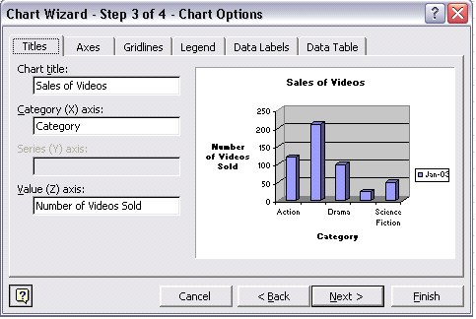

Slide 6
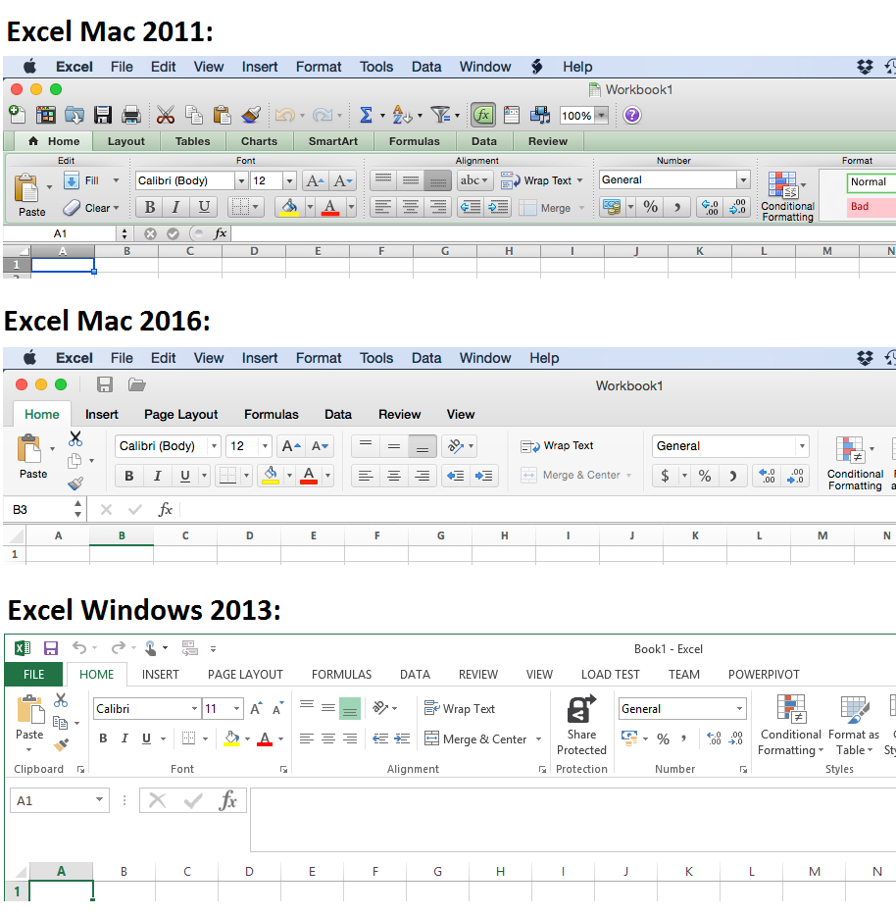

Slide 7
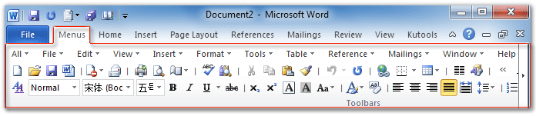
Fitt’s law
Time required to rapidly move to a target area is a function of the ratio between the distance to the target and the width of the target.
See more: http://blogs.msdn.com/b/jensenh/archive/2006/08/22/711808.aspx

Slide 8
KLM – Keystroke Level Model (Kieras 1993)
Code | Operation |  | Time
K | Key press and release (keyboard) | Best Typist (135 wpm) | 0.08 seconds
 |  | Good Typist (90 wpm) | 0.12 seconds
 |  | Poor Typist (40 wpm) | 0.28 seconds
 |  | Average Skilled Typist (55 wpm) | 0.20 seconds
 |  | Average Non-secretary Typist (40 wpm) | 0.28 seconds
 |  | Typing Random Letters | 0.50 seconds
 |  | Typing Complex Codes | 0.75 seconds
 |  | Worst Typist (unfamiliar with keyboard) | 1.20 seconds
P | Point the mouse to an object on screen |  | 1.10 seconds
B | Button press or release (mouse) |  | 0.10 seconds
H | Hand from keyboard to mouse or vice versa |  | 0.40 seconds
M | Mental preparation |  | 1.20 seconds
T(n) | Type string of characters |  | n × K seconds
W(t) | User waiting for the system to respond
D(n0, l0) | Draw n0 straight line segment with mouse of total length l0 centimeters
Source: Wikipedia; see also: http://www.ict.griffith.edu.au/marilyn/uidweek10/klm.pdf

Slide 9
How fast can you type?
Polish version:
http://www.szybkiepisanienaklawiaturze.pl/test.htm
English version:
https://www.goodtyping.com/test.php

Slide 10
How to create a good interface? (Nielsen heuristics)
Visibility of system status
Match between system and the real world
User control and freedom
Consistency and standards
Error prevention
Recognition rather than recall
Flexibility and efficiency of use
Aesthetic and minimalist design
Help users recognize, diagnose, and recover from errors
Help and documentation
More: http://www.nngroup.com/articles/ten-usability-heuristics/

Slide 11
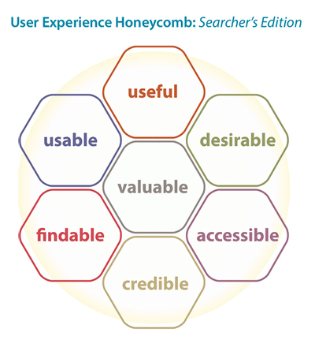
Source: http://marketingland.com/

Slide 12
Some reading…
http://blog.codinghorror.com/fitts-law-and-infinite-width/
http://www.usability.gov/what-and-why/user-experience.html
https://www.smashingmagazine.com/2012/12/fittss-law-and-user-experience/
http://www.asktog.com/columns/022DesignedToGiveFitts.html
https://webflow.com/blog/9-essential-user-interface-ui-design-tips

Slide 13
Task:
Choose a website. Analyse its usability. Find the weak points. Team that finds the worst possible website gets extra credit!
Develop the layout idea of an automated service for a library for a mobile application

Slide 14
https://gomockingbird.com/
http://uxdesign.cc/ux-tools/

